Slide 2
Rescue Plan Act Funding Update
November 1, 2021

Slide 3
Funding Details
Union County allocated $46.6 million
½ now and the remaining ½ in approximately 6-18 months
Funding Objectives:
Support urgent COVID-19 response efforts to continue to decrease spread of the virus and bring the pandemic under control
Replace lost public sector revenue to strengthen support for vital public services and help retain jobs
Support immediate economic stabilization for households and businesses
Address systemic public health and economic challenges that have contributed to the inequal impact of the pandemic
Municipalities received funds directly

Slide 4
Potential Uses
Opportunities to leverage with municipal partners
Grant opportunities for small businesses/non-profits
Property tax relief
Water, sewer, storm water
Broadband (state law restrictions)
Public health programs
Behavioral health programs
Very broad uses allowed …

Slide 5
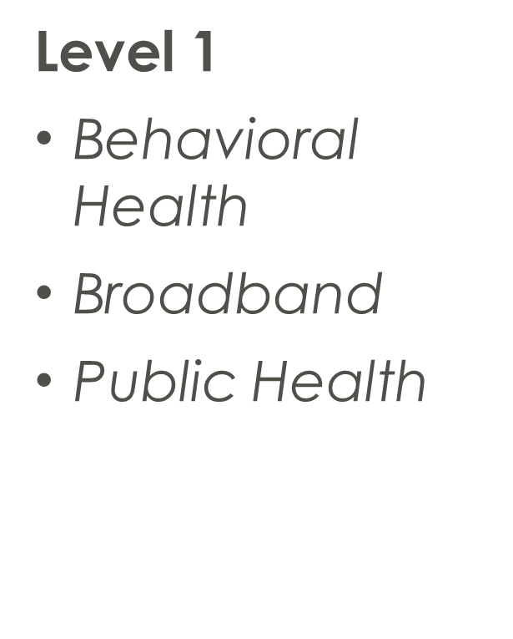
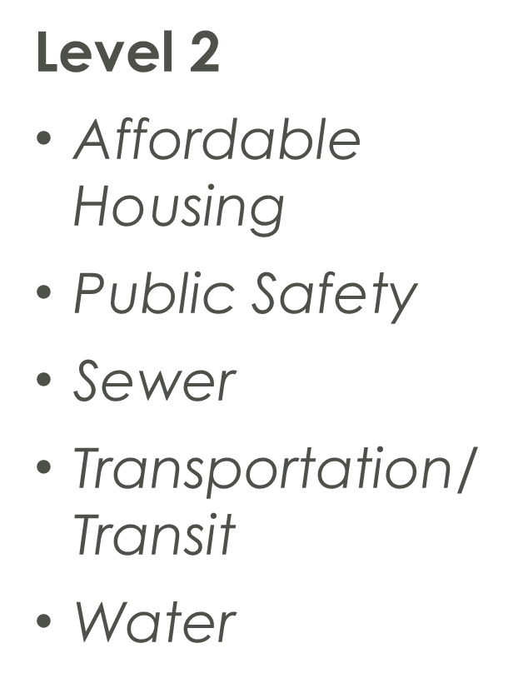
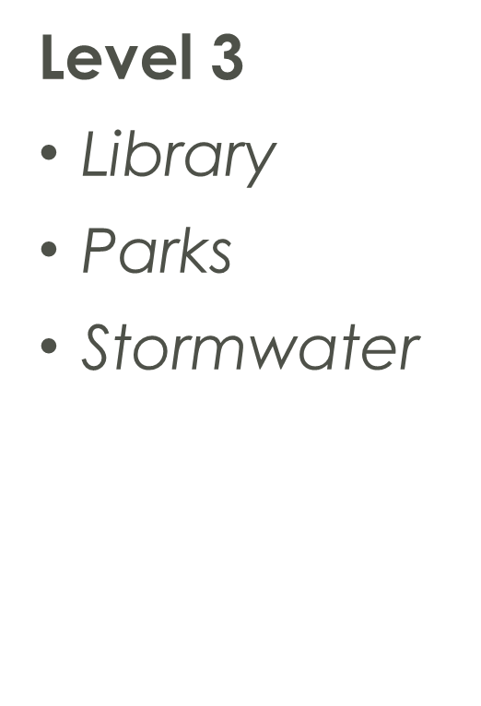
Recovery Act Committee Recommendations

Slide 6
Recommendations
COVID-19 Mitigation 15% Allocation; $7M
Fund COVID-19 mitigation efforts, medical expenses, behavioral healthcare, and certain public health and safety staff.
Strategic Investments in County Services 45% Allocation; $20.9M
Invest to improve access to clean drinking water, support vital wastewater and stormwater infrastructure.
Community and Economic Support 20% Allocation; $9.3M
Address negative economic and supply chain impacts to workers, families, small businesses, impacted industries, and County programs (library, park/recreation, food hub)
Administration 5% Allocation; $2.3M
Manage and coordinate use of funds to ensure transparency and public accountability while maintaining a robust documentation and compliance methodology.
Hold-Back 15% Allocation; $7M
Set aside as a contingency/reserve fund to provide flexibility over the period the funds are available to most appropriately respond to the changing regulatory, economic and public health environment brought on by the pandemic.
Notes:
We anticipate this including public health, broader human services and Sheriff’s office needs.
Water focus
Quality of Life focus – supply chain issues
Documentation/compliance focus
Still a lot of time and many unknowns

Slide 7
Uncertain Environment
Rules are not final
Ongoing congressional efforts
Lack of State budget

Slide 8
Next Steps
Internal Support/Governance Structure
Will be important to make funding decisions that clearly follow Treasury guidelines
Rating agencies will evaluate a government’s use of the ARPA funds in formulating its credit opinion
Will consider government’s level of reserves and structural budget balance, or efforts to return to structural balance, as part of their credit analysis

Slide 9
Governance Structure
Staff from budget, finance, procurement and manager’s office to serve in oversight capacity
Programs/projects for approval in each category will come to the Board for approval
Monthly report to Board regarding programs/projects and use of funds

Slide 10
Questions

